Slide 1

By: Ayah, Divya, Chloe, Jialin, Kyra

Slide 2





Team
Ayah Tharwat
Divya Bachina
Jialin Yu
Chloe Jepson
Kyra Jeckering

Slide 3
The Problem
Overbearing Expenses Related to Campus Living
High prices of textbooks, electronics, furniture, clothing, etc.
Students don’t have access to a commonplace where they can buy used textbooks and other resources from older or graduating students
Other websites and reselling services can compromise the safety of those selling or buying

Slide 4
The Solution
Troyboy: A Web Application to Aid Transactions on Campus
A system that ensures only students and staff at the university can create an account
Items for sale can be posted to a feed for all users to view
Those looking for specific items can filter and search through the feed and related items
Gives students the opportunity to make money by selling gently owned items, as well as saving money on items that would be priced higher in bookstores and other sites

Slide 5
Users & Stakeholders
Users
Students
Staff
Stakeholders
Parents
Environmentalists
Notes:
Parents: save up money by cutting down yearly spending
Environmentalists: reduces the number of natural resources being used and pollution that’s being emitted.

Slide 6
Functional
Requirements
Process
The use of our (an) API
Provide sale opportunities for RPI students
People
Both the buyer and seller must have the ability to use the website
User Interface
Provide an easily accessible website to all users
Design that matches the user’s needs to sell products

Slide 7







Technologies
API
Notes:
We’re going to be using github for version control on our code snippets. We will be using the bootstrap library to build the website using html, css and js. For the additional inbox/chat feature, we’ve decided to use a chat api.

Slide 8
Non-Functional
Requirements
Privacy/Security
Maintainability
Performance
Usability
CAS Authentication
Payments through Venmo/Apple Pay
Display Location during pickup
Scalable code
UX/UI design & development
Clean and efficient code, design, & development
Notes:
the web app has several non-functional requirements that include privacy or security, maintainability, performance, and usability. Students will sign in through their RPI accounts using CAS authentication to confirm all users are RPI students. This ensures privacy within the Troyboy community for each user to safely and freely use our services.To avoid complications, payments between users will be outsourced by applications such as Venmo or ApplePay. A user’s address is only given after seller confirms transaction.Since we have hopes to make this a longterm application for RPI, having scalable code is important for maintainability. And UX/UI design and development for performance and usability.

Slide 9
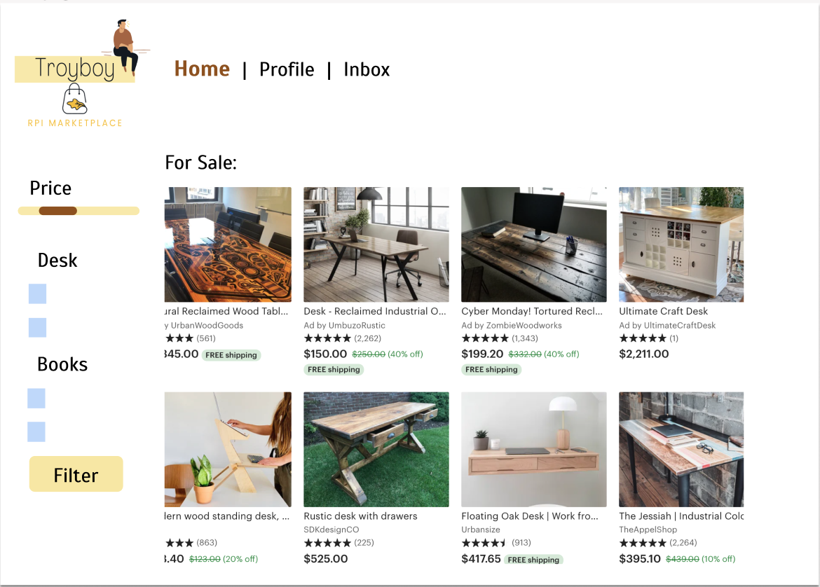
Homepage
HTML, CSS, JS
Notes:
The homepage will feature the items that other students are selling and they can filter through products similar to craigslist using the filter.

Slide 10
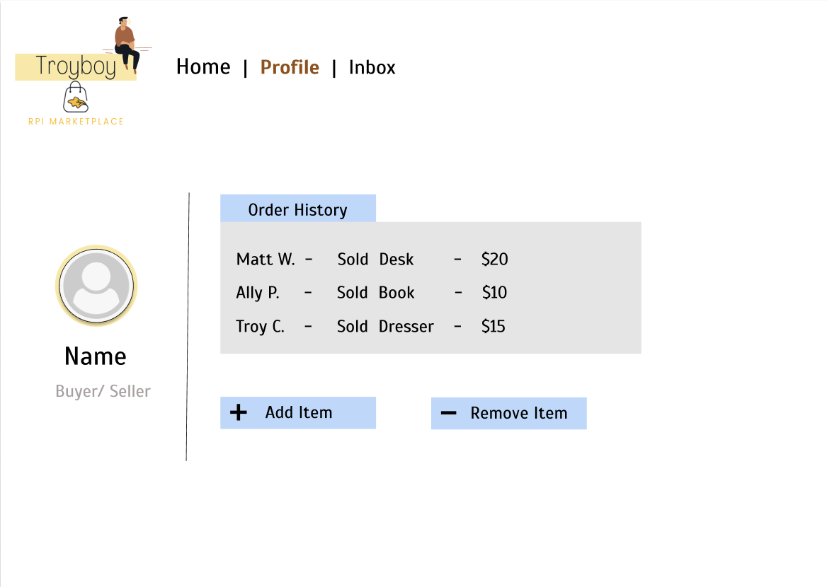
Profile
Database
(MongoDB)
Notes:
For the profile, there you can see your order history and then you can add an item you want to sell or remove an item. We will keep track of this information through a database.

Slide 11
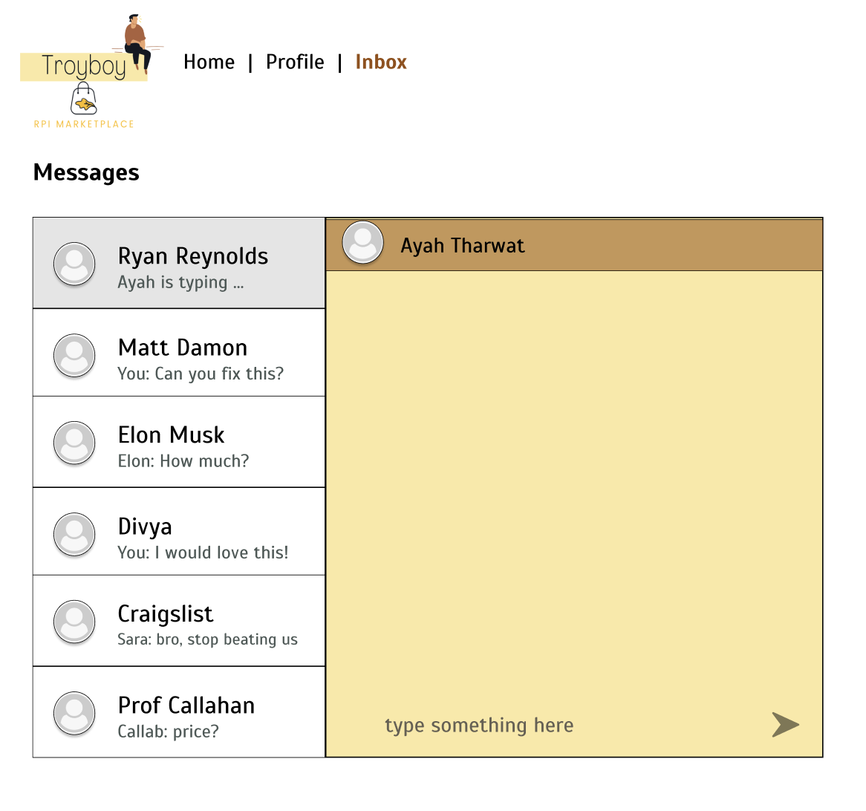
Inbox
Chat API
Notes:
Then we thought it was a good idea to add a inbox for 2 users to communicate to ask about items or prices. To make it easier, we will use a chat API like whatsapp.

Slide 12
THANKS!
Any questions?

